Slide 1
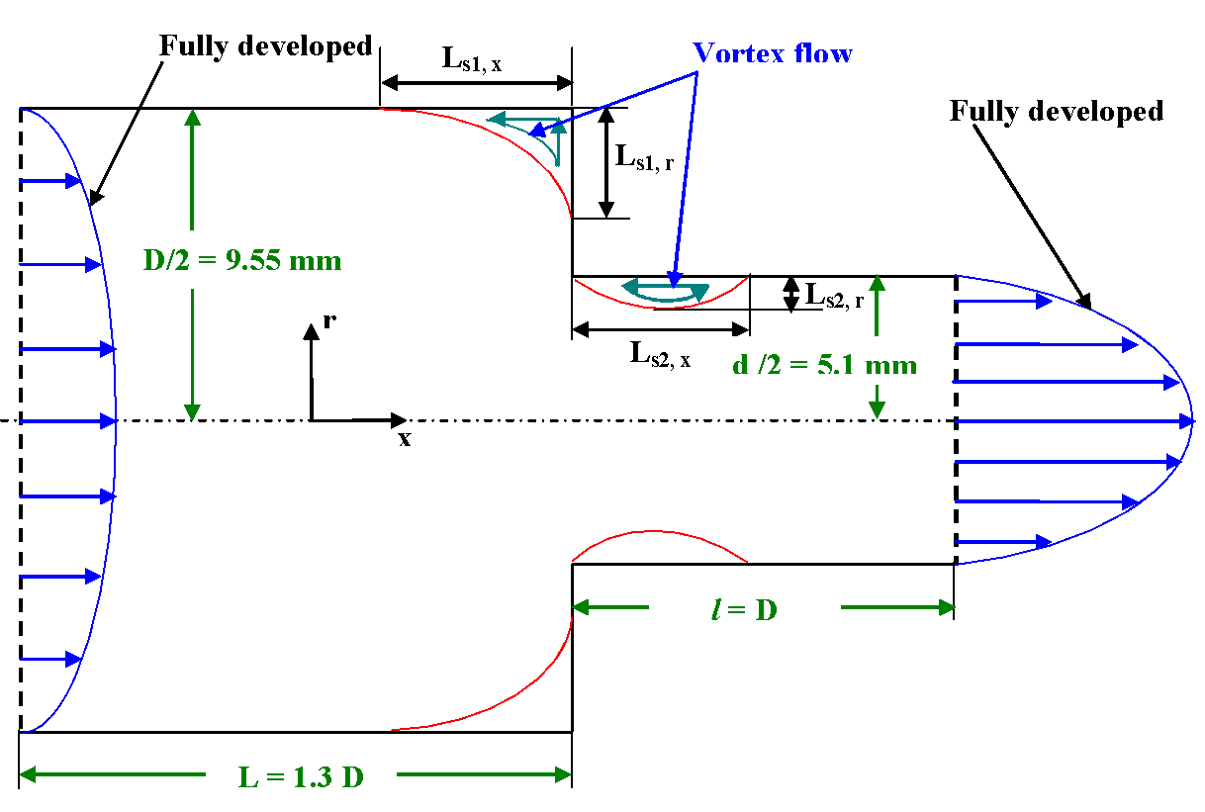
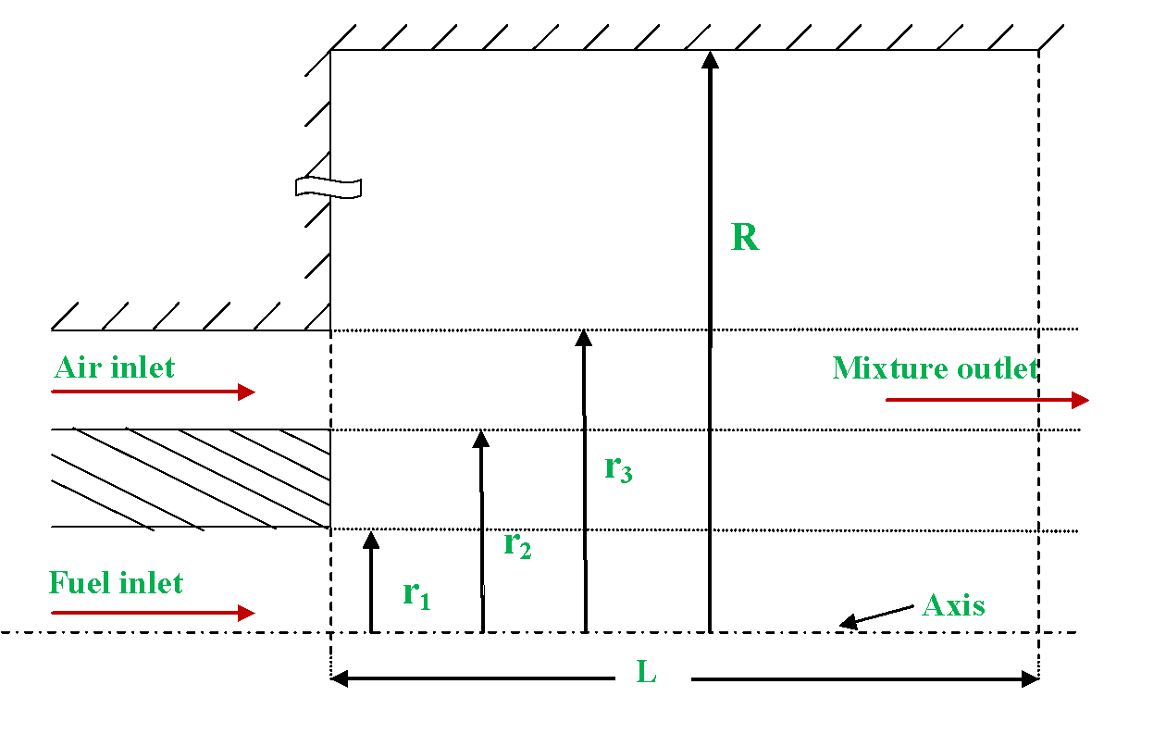
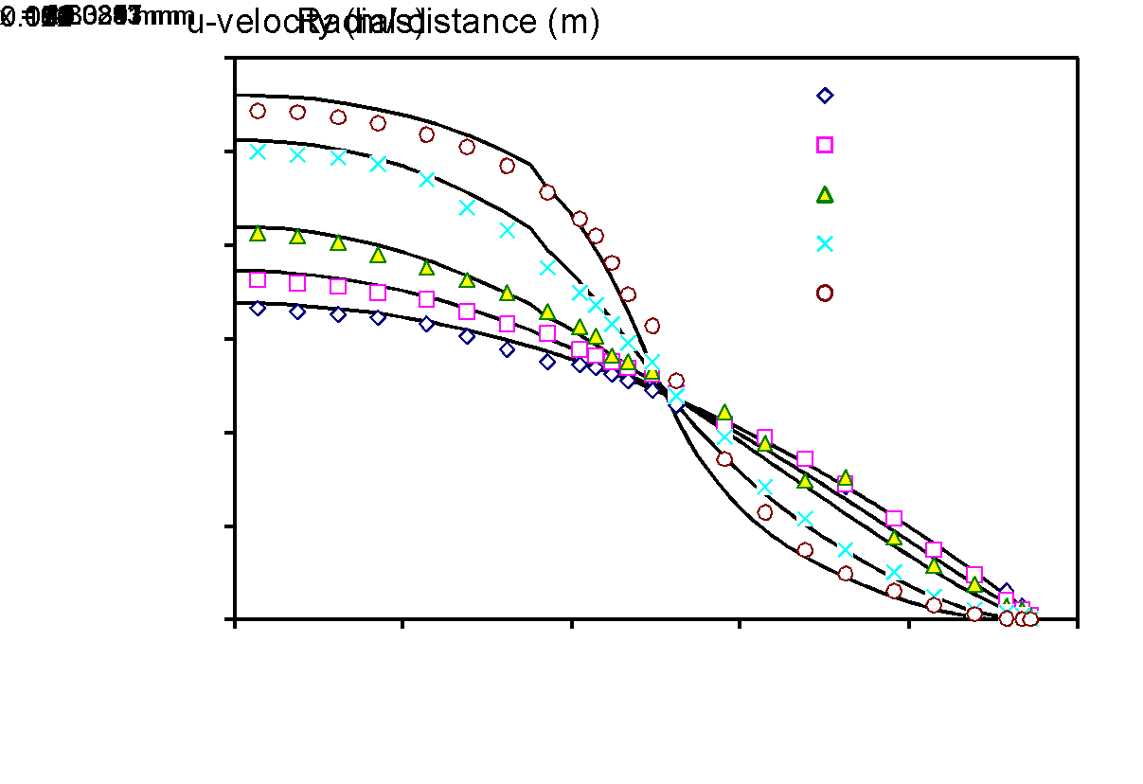
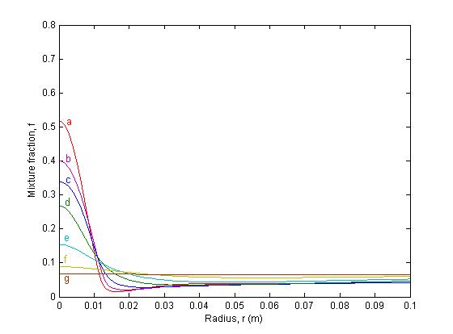
Title of the paper
Author¹, Author², Author³
Department and Institute with full address
E-mail: author 1@..................
xxx-NCWAM 2025
ABSTRACT
EXPERIMENTAL PROCEDURE OR MATHEMATICAL MODELLING
A Finite-Volume (FV) based 2-D axisymmetric diffusion-flame model is developed to study the combustion phenomenon in a confined reactor.
RESULTS
Figure 1 Caption
Figure 3 Caption
a: x=95 mm
b: x=175 mm
c: x=246 mm
d: x=327 mm
e: x=398 mm
f: x=436 mm
g: x=632 mm
Figure 2 Caption
Figure 4 Caption
CONCLUSIONS
REFERENCES
National Conference on Challenges in Welding and Additive Manufacturing (NCWAM 2025), 27th & 28th February 2025, BITS-Pilani, Hyderabad Campus

